Slide 1
Foundations of Machine Learning
Module 2: Linear Regression and Decision Tree
Part B: Introduction to Decision Tree
Sudeshna Sarkar
IIT Kharagpur

Slide 2
Definition
A decision tree is a classifier in the form of a tree structure with two types of nodes:
Decision node: Specifies a choice or test of some attribute, with one branch for each outcome
Leaf node: Indicates classification of an example

Slide 3
Decision Tree Example 1 Whether to approve a loan
Employed?
No
Yes
Credit Score?
Income?
High
Low
High
Low
Approve
Reject
Approve
Reject

Slide 4
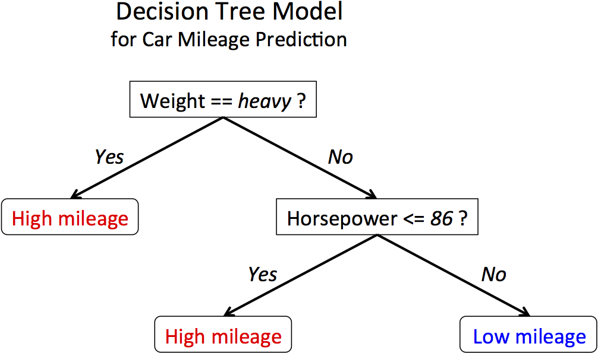
Decision Tree Example 3

Slide 5
Issues
Given some training examples, what decision tree should be generated?
One proposal: prefer the smallest tree that is consistent with the data (Bias)
the tree with the least depth?
the tree with the fewest nodes?
Possible method:
search the space of decision trees for the smallest decision tree that fits the data

Slide 6
Example Data
Training Examples:
 | Action | Author | Thread | Length | Where
e1 | skips | known | new | long | Home
e2 | reads | unknown | new | short | Work
e3 | skips | unknown | old | long | Work
e4 | skips | known | old | long | home
e5 | reads | known | new | short | home
e6 | skips | known | old | long | work
New Examples:
e7 | ??? | known | new | short | work
e8 | ??? | unknown | new | short | work

Slide 7
Possible splits
length
skips 9
reads 9
long
short
thread
skips 9
reads 9
Skips 2
Reads 9
Skips 7
Reads 0
new
old
Skips 6
Reads 2
Skips 3
Reads 7

Slide 8
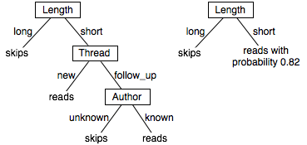
Two Example DTs

Slide 9
Decision Tree for PlayTennis
Attributes and their values:
Outlook: Sunny, Overcast, Rain
Humidity: High, Normal
Wind: Strong, Weak
Temperature: Hot, Mild, Cool
Target concept - Play Tennis: Yes, No

Slide 10
Decision Tree for PlayTennis
Outlook
Sunny
Overcast
Rain
Humidity
Yes
Wind
High
Normal
Strong
Weak
No
Yes
No
Yes

Slide 11
Decision Tree for PlayTennis
Outlook
Sunny
Overcast
Rain
Humidity
Each internal node tests an attribute
High
Normal
Each branch corresponds to an
attribute value node
No
Yes
Each leaf node assigns a classification

Slide 12
Decision Tree for PlayTennis
Outlook Temperature Humidity Wind PlayTennis
Sunny Hot High Weak ?
No
Outlook
Sunny
Overcast
Rain
Humidity
Yes
Wind
High
Normal
Strong
Weak
No
Yes
No
Yes

Slide 13
Decision Tree
decision trees represent disjunctions of conjunctions
Outlook
Sunny
Overcast
Rain
Humidity
Yes
Wind
High
Normal
Strong
Weak
No
Yes
No
Yes
(Outlook=Sunny ∧ Humidity=Normal)
∨ (Outlook=Overcast)
∨ (Outlook=Rain ∧ Wind=Weak)

Slide 14
Searching for a good tree
How should you go about building a decision tree?
The space of decision trees is too big for systematic search.
Stop and
return the a value for the target feature or
a distribution over target feature values
Choose a test (e.g. an input feature) to split on.
For each value of the test, build a subtree for those examples with this value for the test.

Slide 15
Top-Down Induction of Decision Trees ID3
1. Which node to proceed with?
A ← the “best” decision attribute for next node
Assign A as decision attribute for node
For each value of A create new descendant
Sort training examples to leaf node according to the attribute value of the branch
If all training examples are perfectly classified (same value of target attribute) stop, else iterate over new leaf nodes.
2. When to stop?

Slide 16
Choices
When to stop
no more input features
all examples are classified the same
too few examples to make an informative split
Which test to split on
split gives smallest error.
With multi-valued features
split on all values or
split values into half.

